Slide 1
Project Presentation of Back End Engineering Project (BEE) (22CS026)
On
Consult Us
Shubham Jain (2210992365)
Shubham Bansal (2210992361)
Shubham Verma (2210992372)
Shubham Thakur (2210992371)
Shubham (2210992360)
Supervised By:
Mr. Suhaib Khan
Department of Computer Science and Engineering,
Chitkara University, Punjab

Slide 2
Introduction
"Consult Us" is a user-friendly website designed to simplify healthcare access. Users can easily find nearby doctors, learn about them, and book appointments. Built using HTML, CSS, JavaScript, Node.js, and MongoDB, the platform provides a seamless and efficient experience for managing healthcare needs.
Focusing on user convenience, it allows individuals to quickly locate medical professionals based on their location. The platform offers detailed profiles of doctors, including their specializations and patient reviews, to help users make informed choices. The straightforward booking and confirmation system ensures that appointments are scheduled efficiently. By leveraging modern web technologies, the site enhances the overall healthcare experience, making it more accessible and reliable for everyone.
2

Slide 3
Purpose
The purpose of "Consult Us" is to provide a streamlined, user-friendly platform for accessing healthcare services.
The website aims to Enhance Accessibility by making it easier for users to find healthcare professionals based on their location and specific needs.
It aims to Provide Information by offering comprehensive information about doctors, including their qualifications, specializations, and patient reviews, to help users make informed healthcare decisions.
The platform aims to Simplify Appointment Scheduling by allowing users to book and confirm medical appointments quickly and efficiently, reducing the hassle of traditional scheduling methods.
It aims to Improve User Experience by leveraging modern web technologies to create a reliable and seamless experience, ensuring healthcare services are more accessible and convenient for everyone.

Slide 4
Overview
The primary goal of the "Consult Us" website is to connect users with healthcare providers by allowing them to locate nearby doctors, access detailed information about each doctor, and easily book and confirm appointments online.
Key Features of the Project:
Find Nearby Doctors: Users can search for doctors based on their location, ensuring quick access to medical professionals when needed.
Doctor Profiles: The platform offers detailed profiles of doctors, including their specializations, qualifications, and patient reviews, enabling users to make informed healthcare choices.
Appointment Booking: Users can schedule and confirm appointments directly through the website, simplifying the process of managing healthcare appointments.

Slide 5
Problem Statement
Accessing healthcare services can often be a complex and time-consuming process for many individuals. Patients face challenges such as finding reliable doctors near their location, understanding the qualifications and specialties of different healthcare providers, and managing appointment bookings effectively. These difficulties can lead to delays in receiving medical care, uncertainty in choosing the right healthcare professional, and frustration with traditional appointment scheduling methods.
There is a need for a streamlined, user-friendly solution that simplifies the process of locating doctors, learning about their qualifications and specializations, and booking and confirming appointments efficiently. A digital platform that addresses these pain points can enhance the overall healthcare experience, making it more accessible, reliable, and convenient for users.

Slide 6
Technology Used
Front-end: The project is developed using HTML, CSS, and JavaScript, providing a responsive and user-friendly interface.
Server-side: Node.js is used for server-side operations, ensuring scalability and performance.
Database: MongoDB serves as the database, efficiently managing user and doctor data.

Slide 7
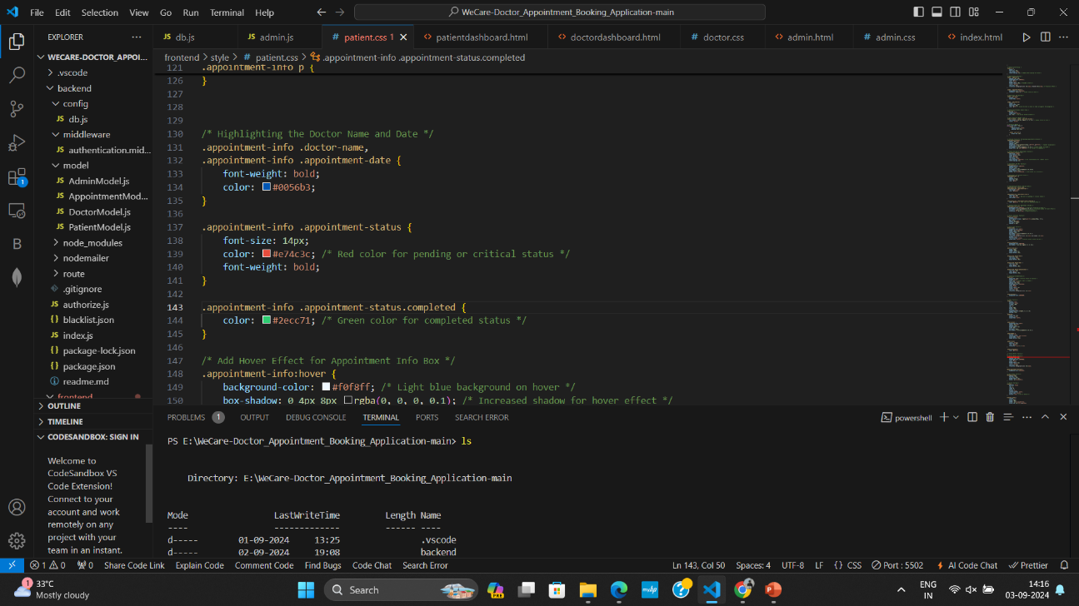
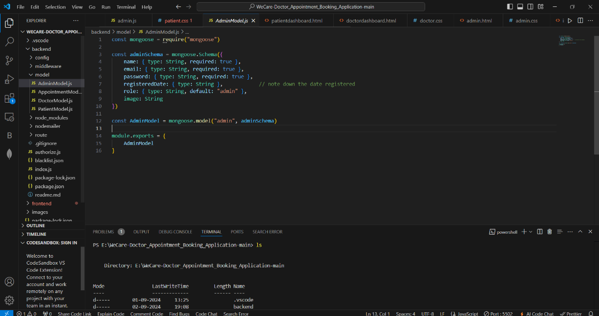
Code Snippets

Slide 8
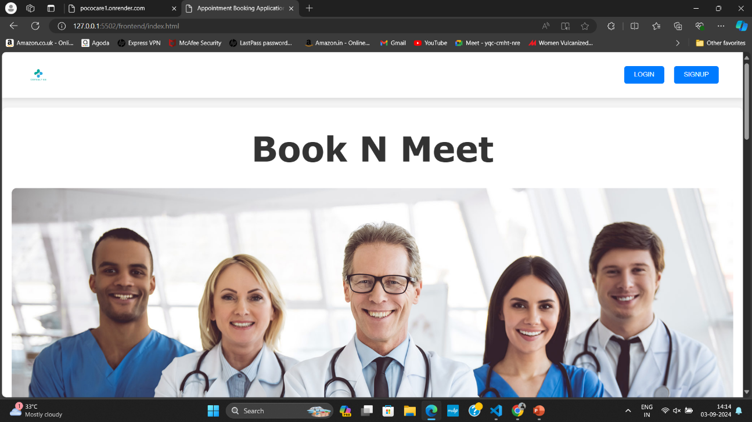
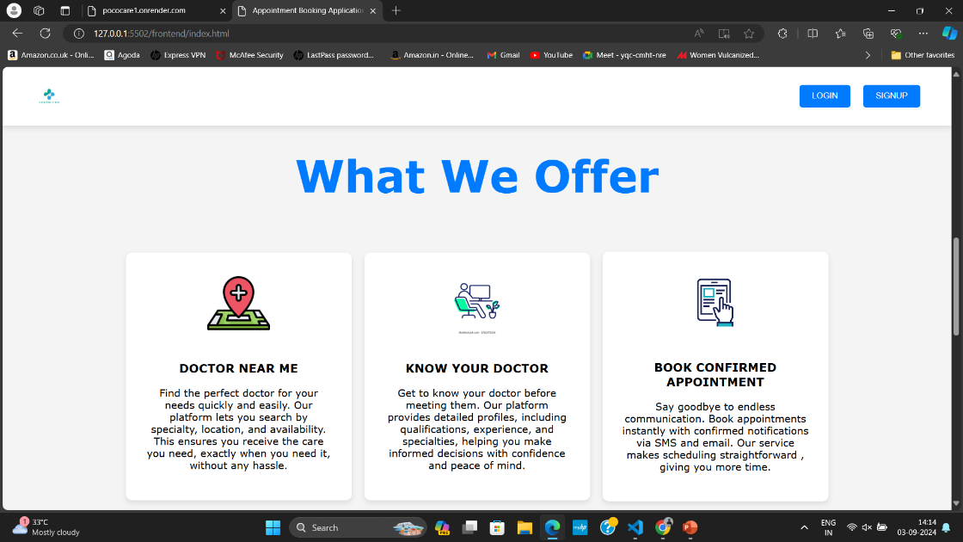
Project view

Slide 9
Project View

Slide 10
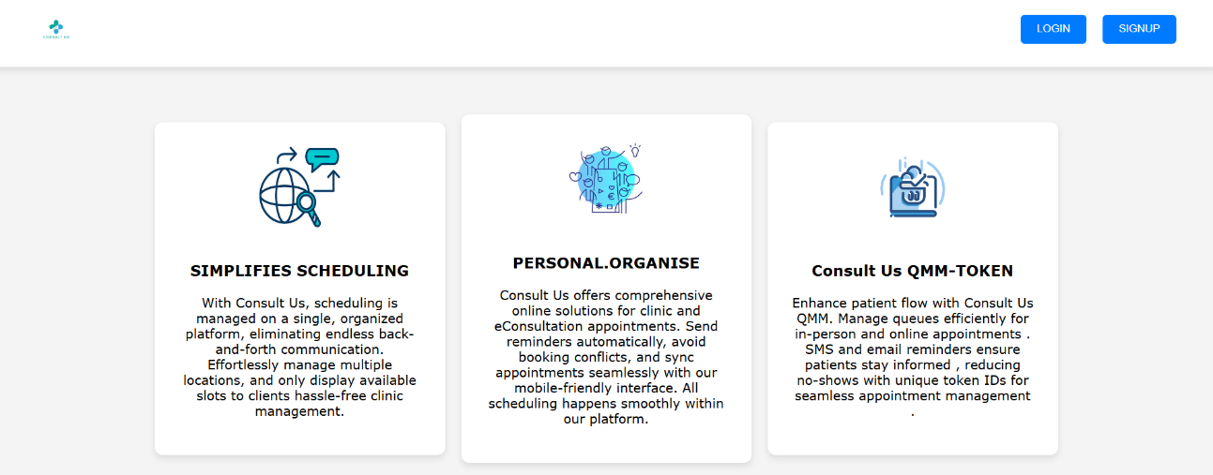
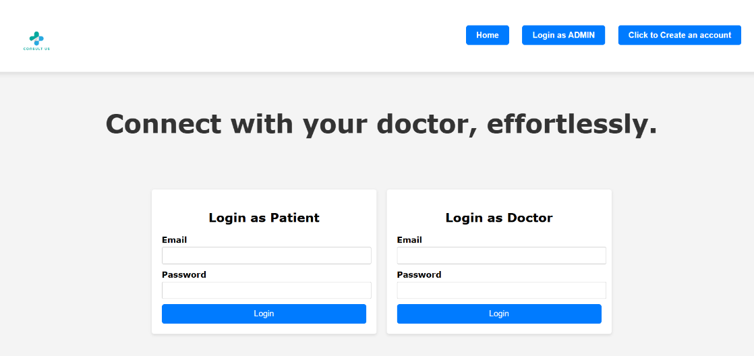
Code Snippets

Slide 11
Future Scope
Telemedicine Integration: Incorporate video consultation features to allow users to have remote doctor appointments, making healthcare accessible even from home.
Mobile App Development: Develop a mobile app version of the platform, providing users with on-the-go access to doctor searches, appointment bookings, and healthcare information.
Health Record Management: Implement a secure system for users to store and share their medical records digitally, ensuring easy access and better continuity of care.
AI-Powered Personalization: Use artificial intelligence to offer personalized recommendations for doctors and healthcare services based on user preferences and medical history.
Insurance Integration: Add features that show which doctors and services are covered under users' health insurance plans, simplifying the healthcare selection process.

Slide 12
Conclusion
The "Consult Us" platform connects users with healthcare providers.
Key features:
Find nearby doctors
Doctor profiles
Online appointment booking
User reviews and ratings
Personalized health advice
Secure and confidential health records
The platform has the potential to revolutionize the healthcare industry by providing a convenient, accessible, and personalized way for users to connect with healthcare provider.
It aims to improve the overall quality of healthcare by facilitating timely and informed decisions.

Slide 13
Thank You
13

